Slide 1
DeepSeek-R1
不走寻常路

Slide 2
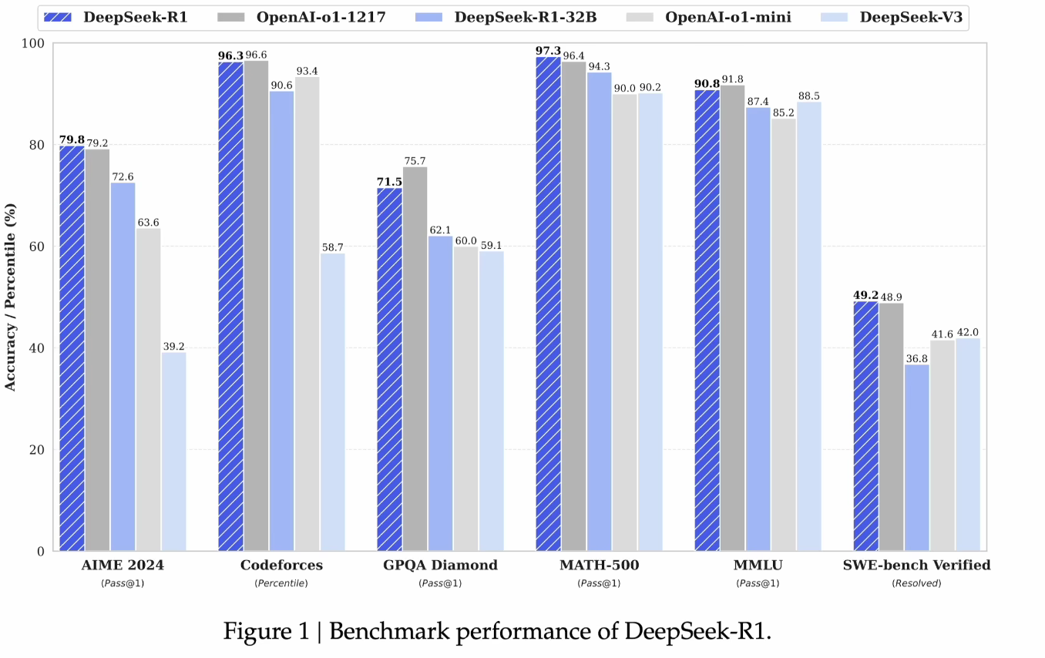

Slide 3
context
AGI（Artificial General Intelligence）
Policy model
Value model
Reinforcement learning
Reward hacking
Monte Carlo simulation

Slide 4
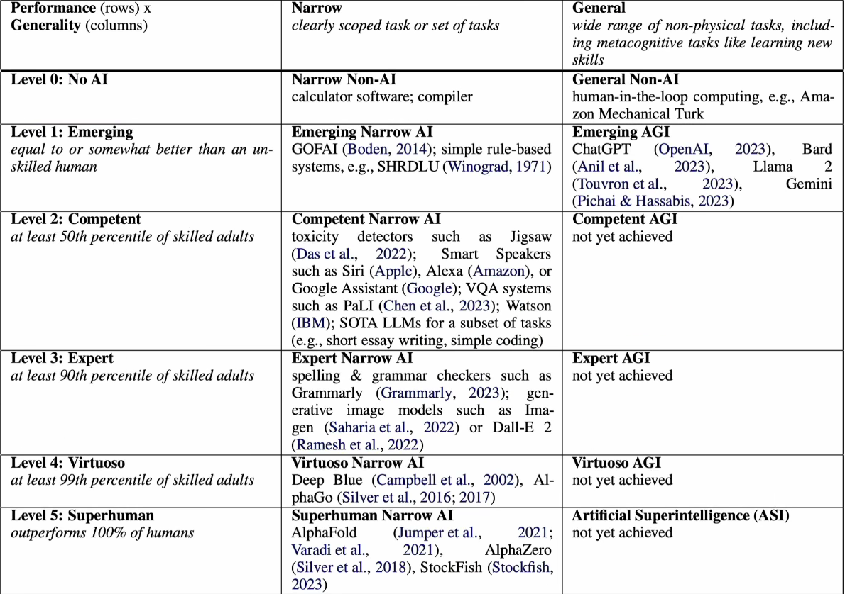
From paper：Position：Levels of AGI for Operationalizing Progress on the Path to AGI(Google and Deepmind）
2024.07

Slide 5
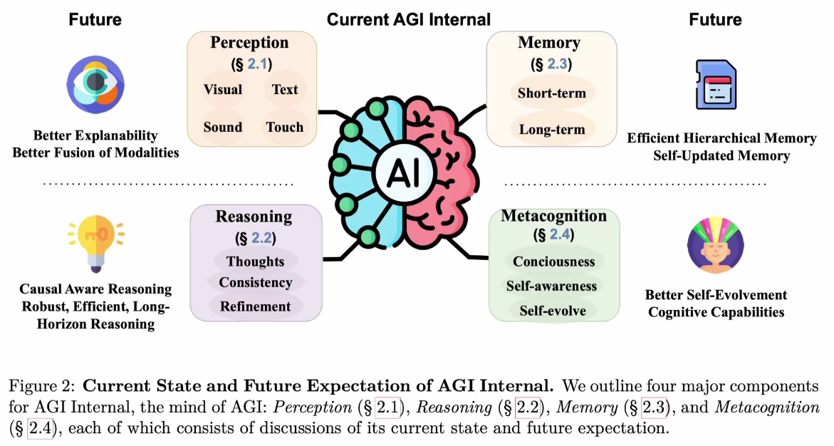
From Paper: How Far Are We From AGl: Are LLMs All We Need? (openai)
2024.10

Slide 6
How
Supervised learning
Unsupervised learning; self-supervised learning
Reinforcement learning

Slide 7
Multi-step decision making
state
agent
action
reward
environment

Slide 8
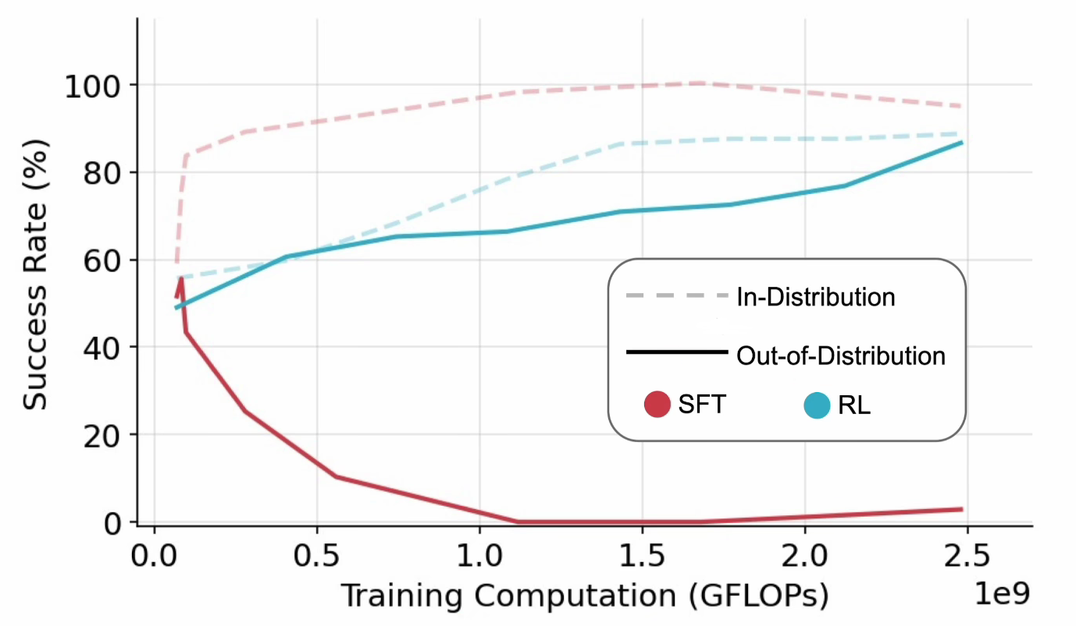
From paper: SFT Memorizes, RL Generalizes:A Comparative Study of Foundation Model Post-training(google)
2025.01

Slide 9
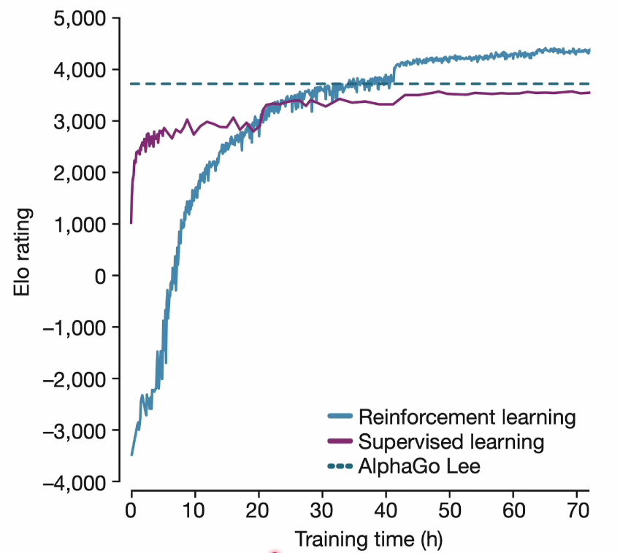
From paper: Mastering the game of Go withouthuman knowledge(deepmind)
nature 2017.03

Slide 10
Supervised
Input → NN →Pred ←GT
SL: → → → → →(Move)
policy base
NN
value base
State → ground truth
Out of distribution
Reinforcement
RL: → → → → → Reward

Slide 11
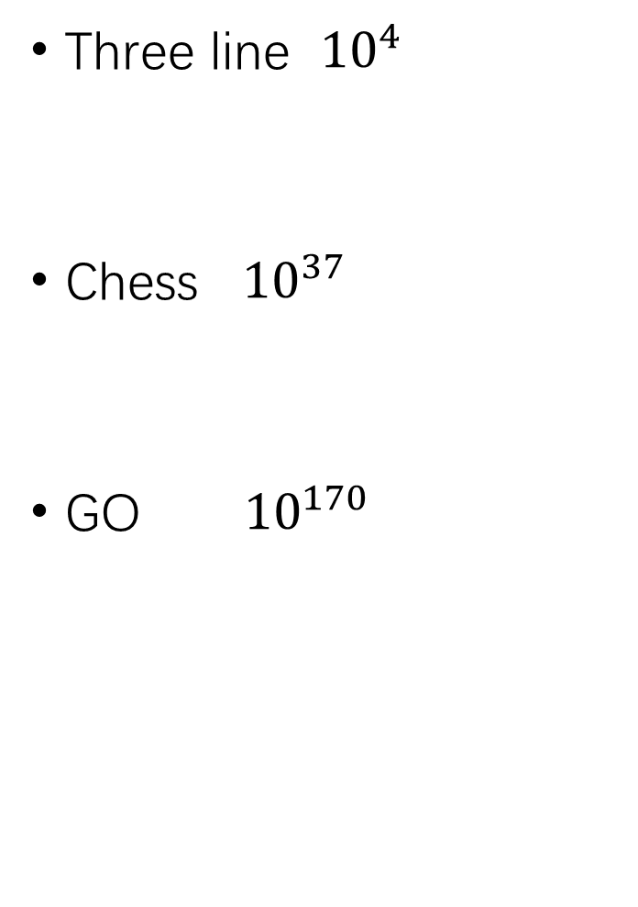
AlphaGO/AlphaZERO
Supervised learning
Reinforcement learning
Value network
Three line ${10}^{4}$
Chess ${10}^{37}$
GO ${10}^{170}$

Slide 12
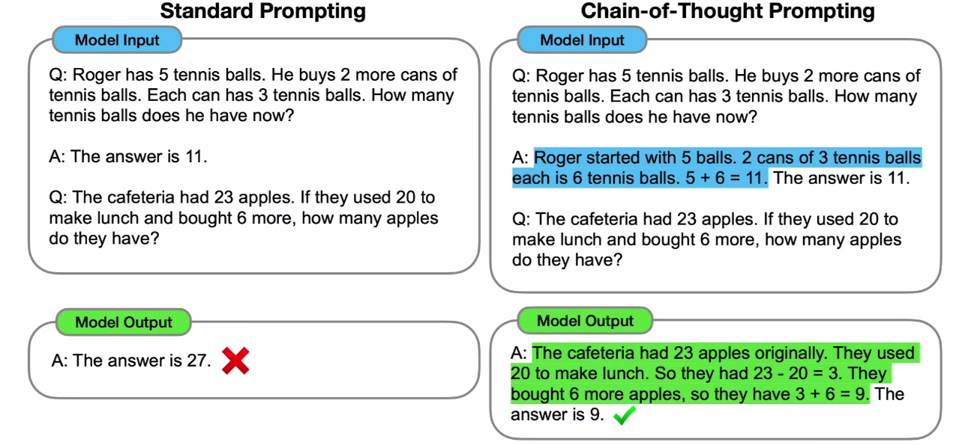
CoT（Chain of Thought)
Chain-of-Thought Prompting Elicits Reasoningin Large Language Models
2022.09

Slide 13
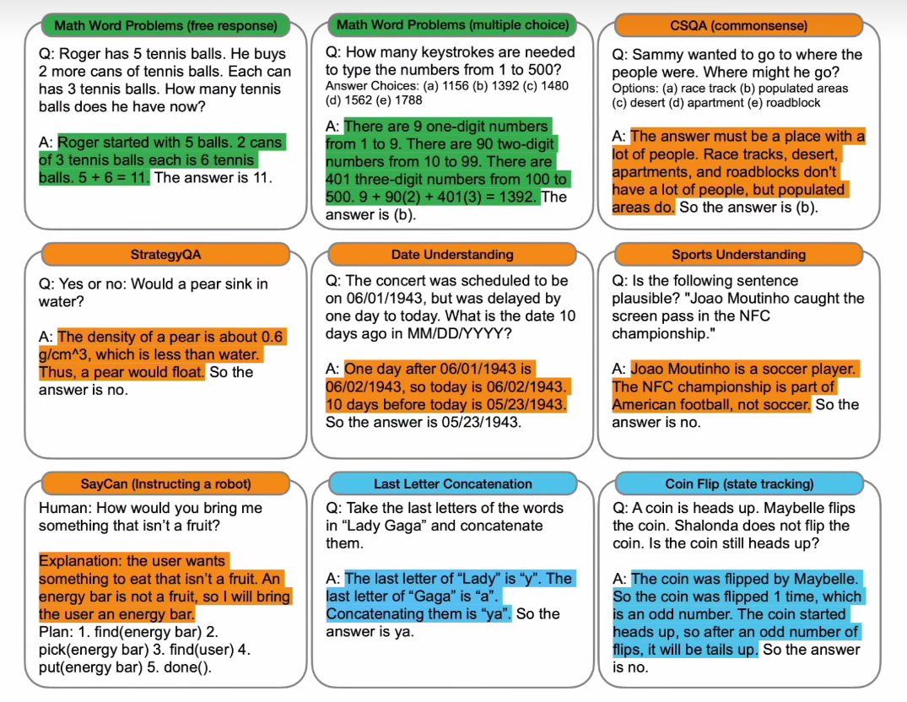

Slide 14
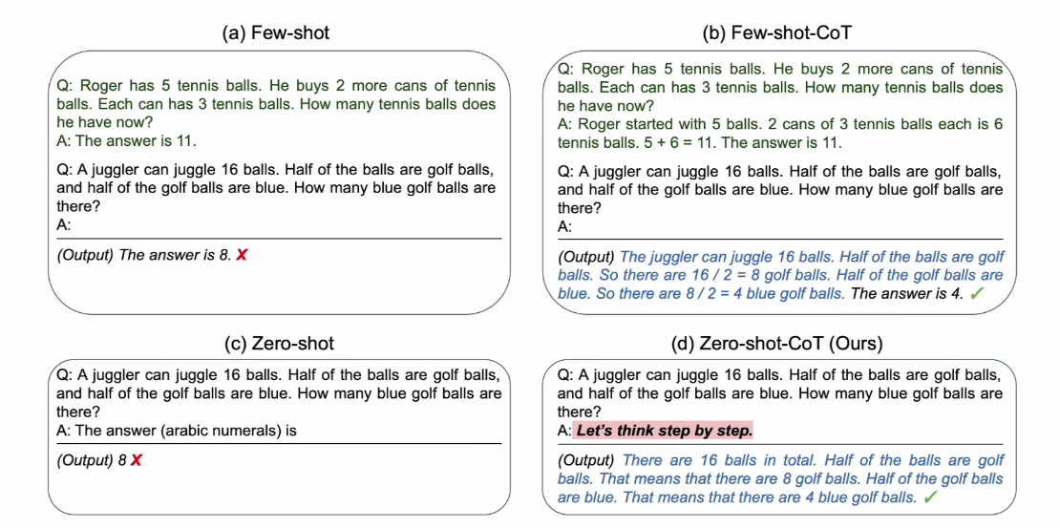
Large Language Models are Zero-Shot Reasoners
2024.03

Slide 15
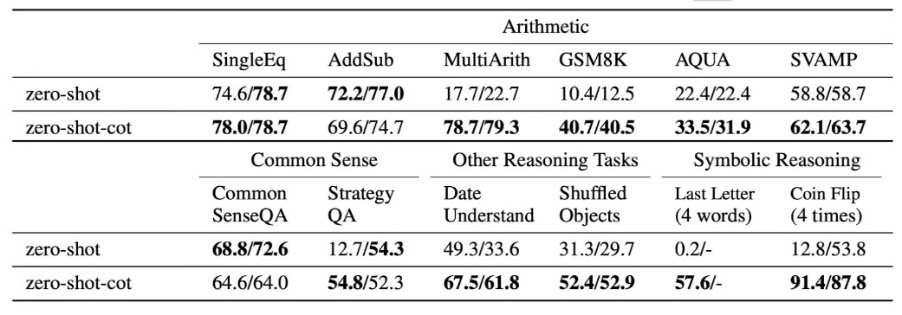

Slide 16
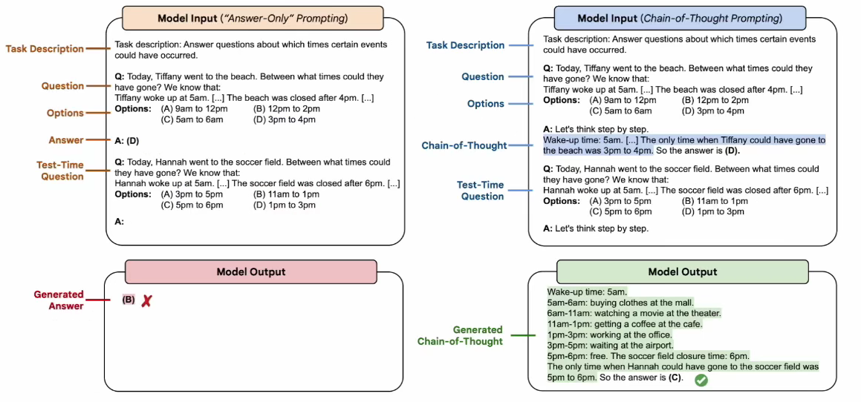
Challenging BIG-Bench tasks andwhether chain-of-thought can solve them

Slide 17
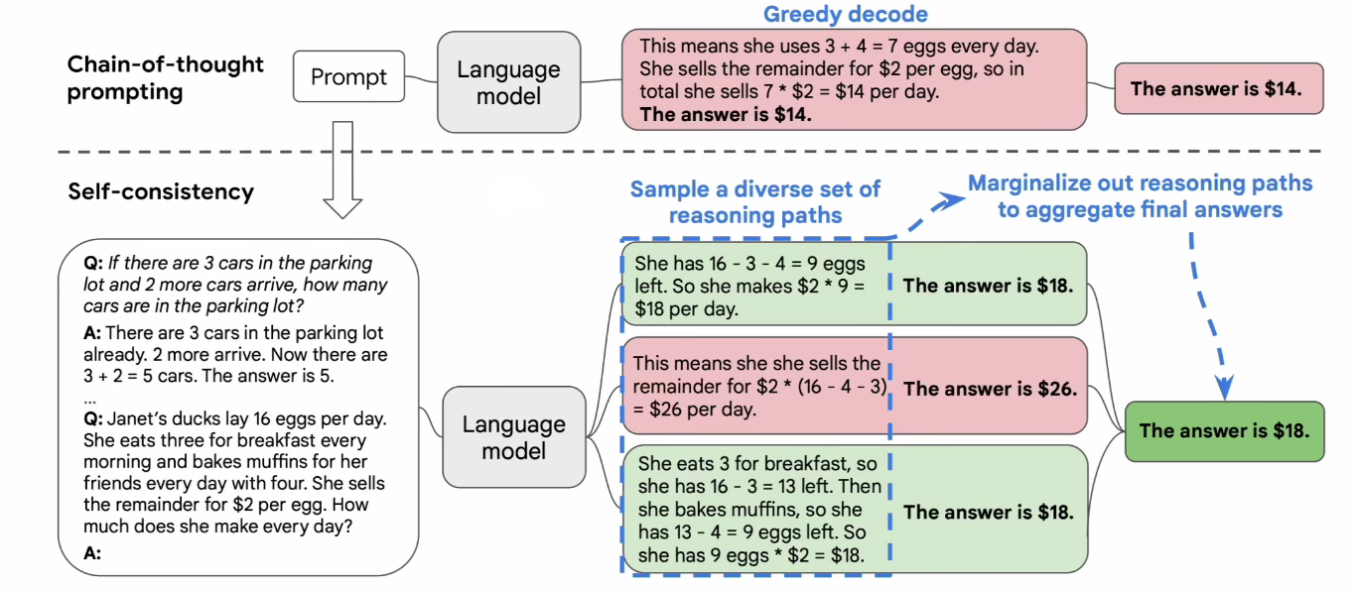
SELF-CONSISTENCY IMPROVES CHAIN OF THOUGHTREASONING IN LANGUAGE MODELS

Slide 18
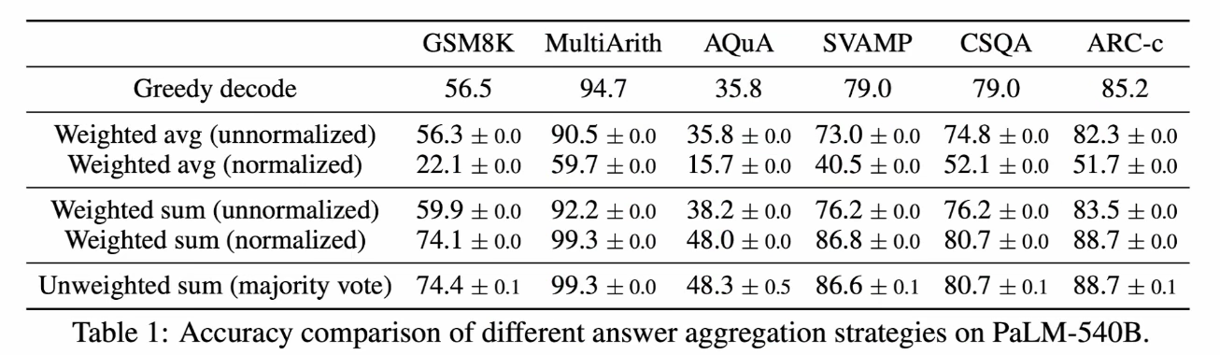
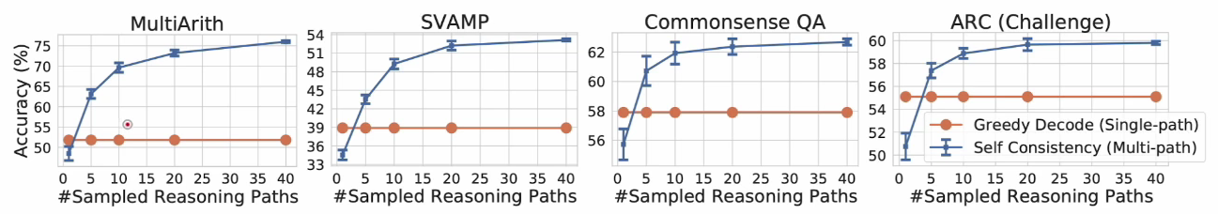

Slide 19
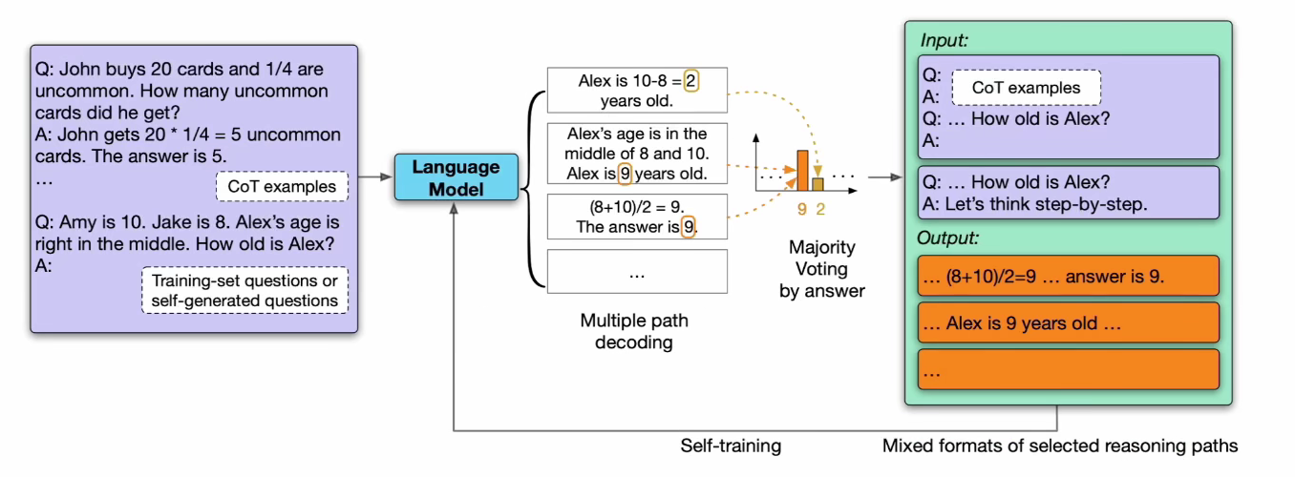
LARGE LANGUAGE MODELS CAN SELF-IMPROVE

Slide 20
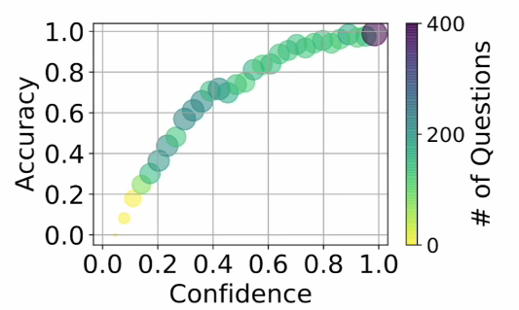
LARGE LANGUAGE MODELS CAN SELF-IMPROVE

Slide 21
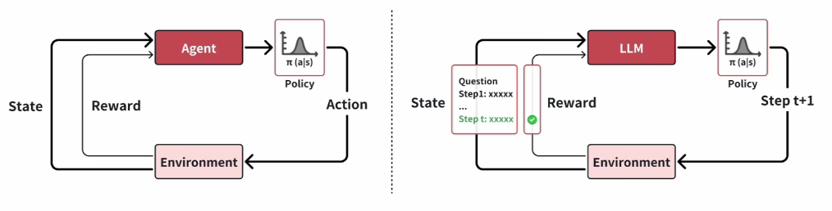
A Roadmap to ol from Reinforcement Learning Perspective

Slide 22
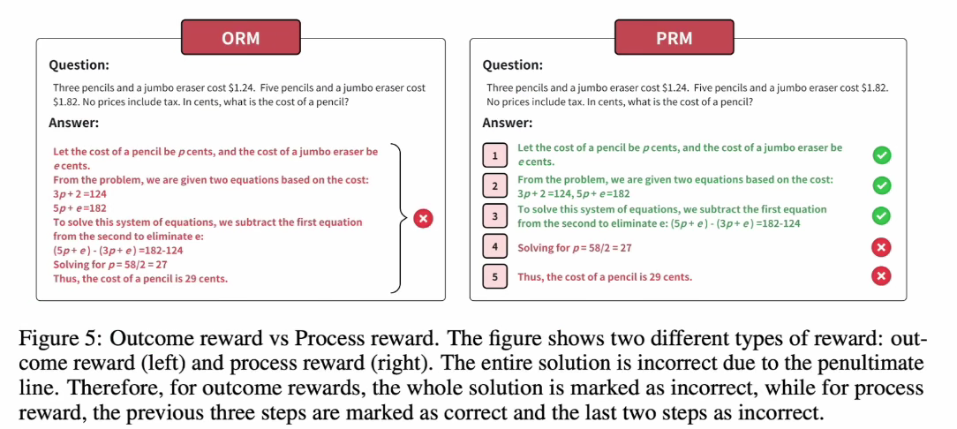

Slide 23
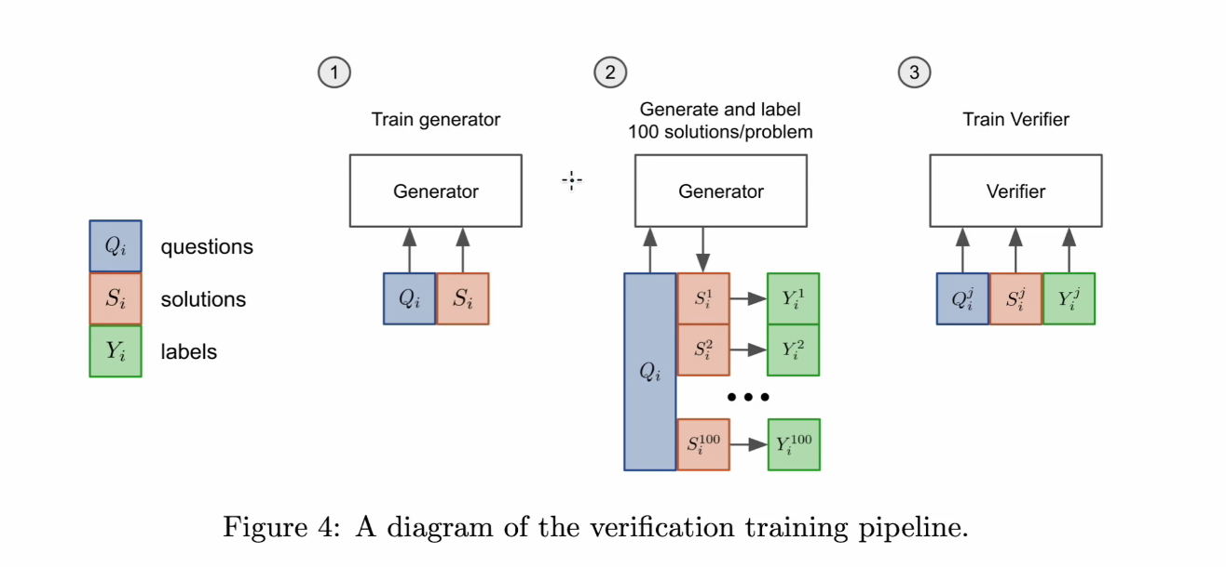

Slide 24
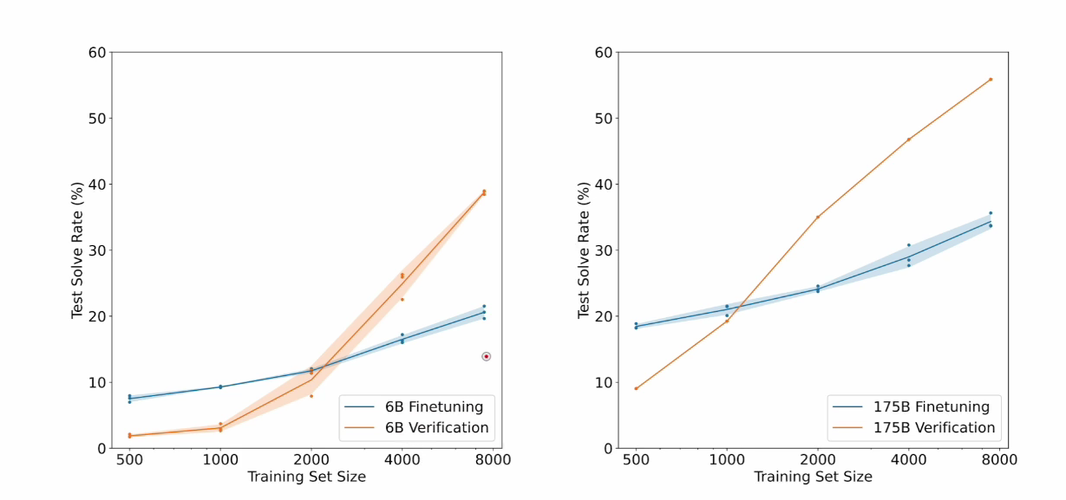

Slide 25
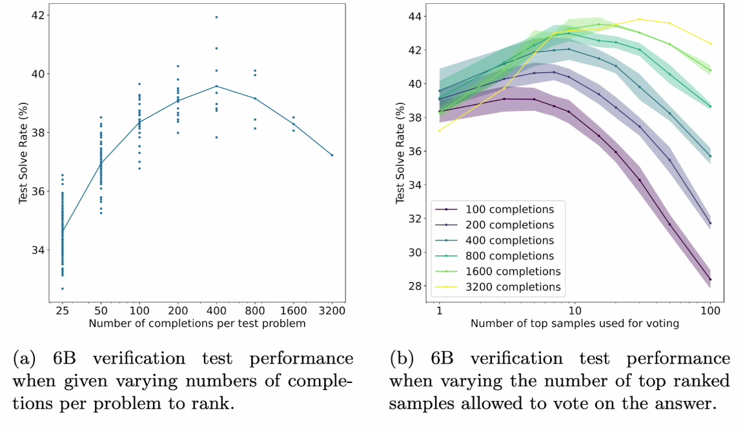

Slide 26
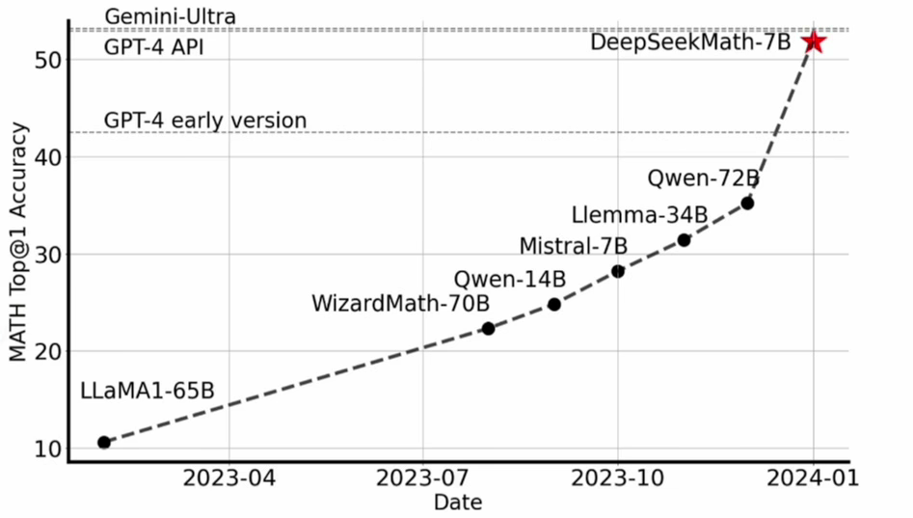
GRPO（based Deepseek-math）

Slide 27
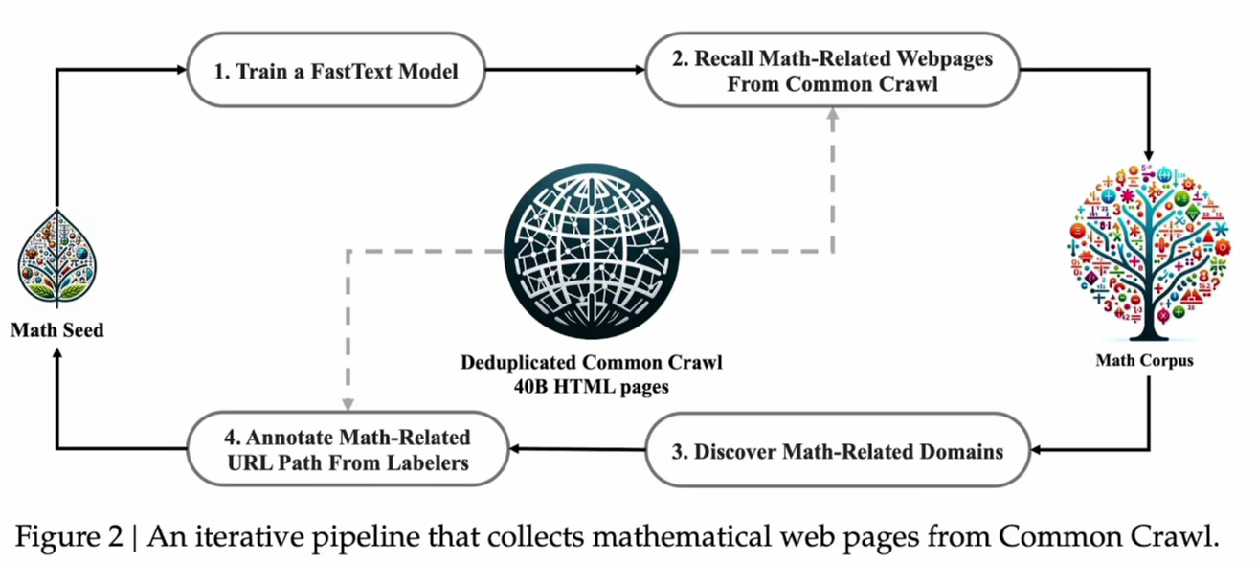
Pre-training

Slide 28
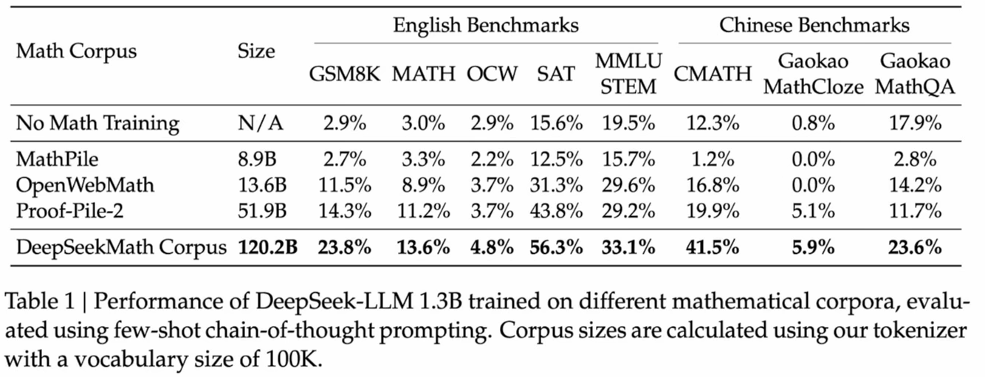

Slide 29
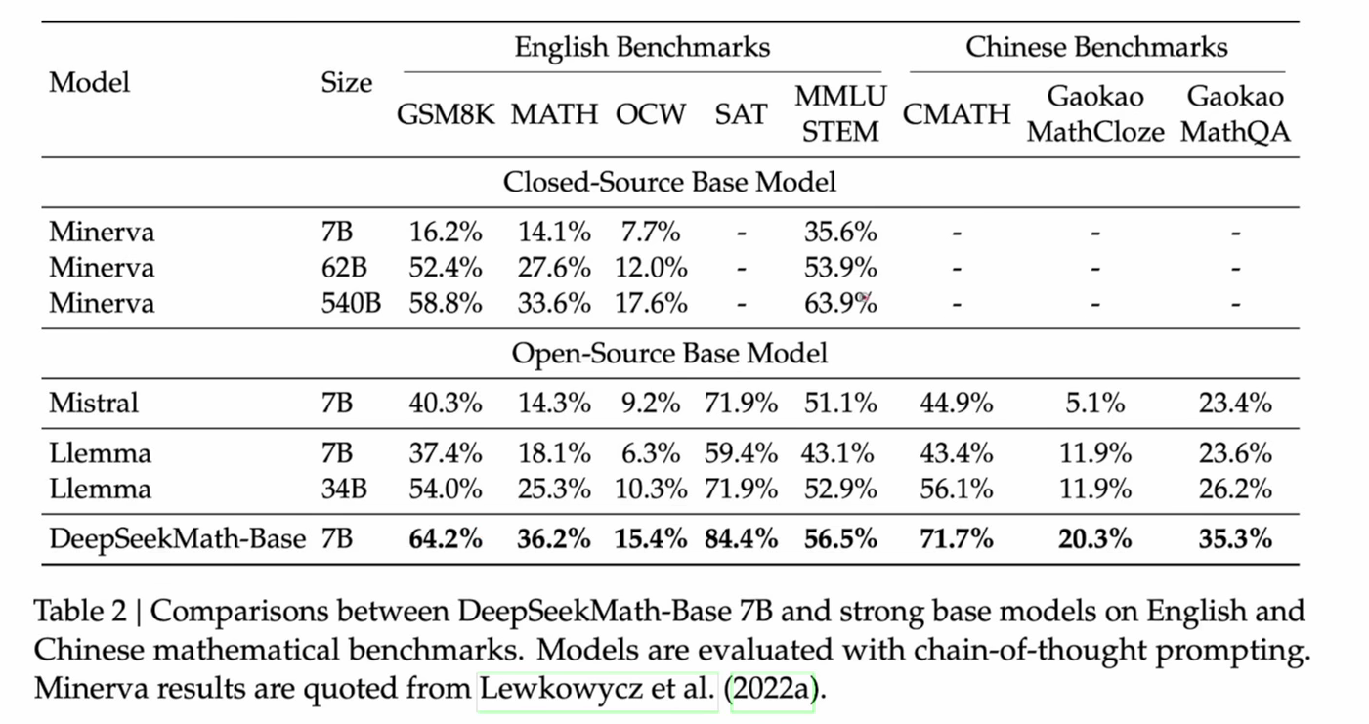

Slide 30
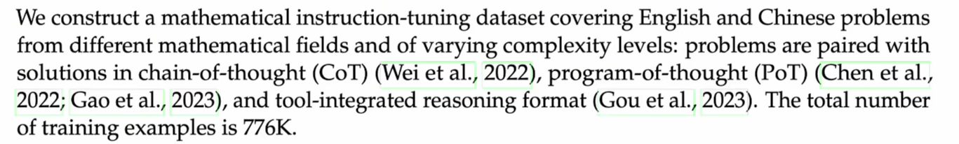
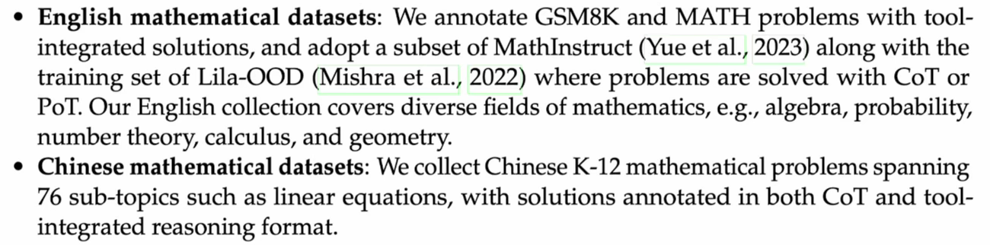
Supervised fine tuning

Slide 31
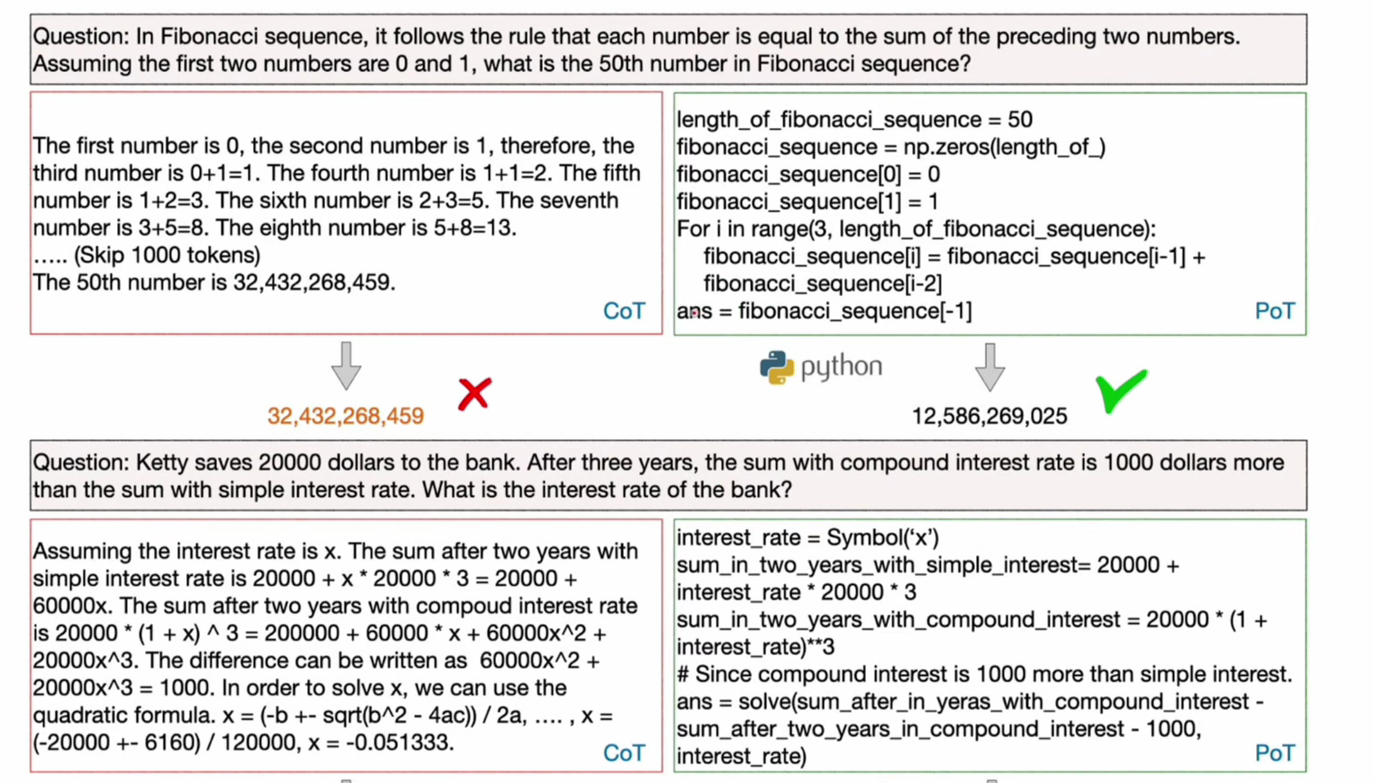

Slide 32
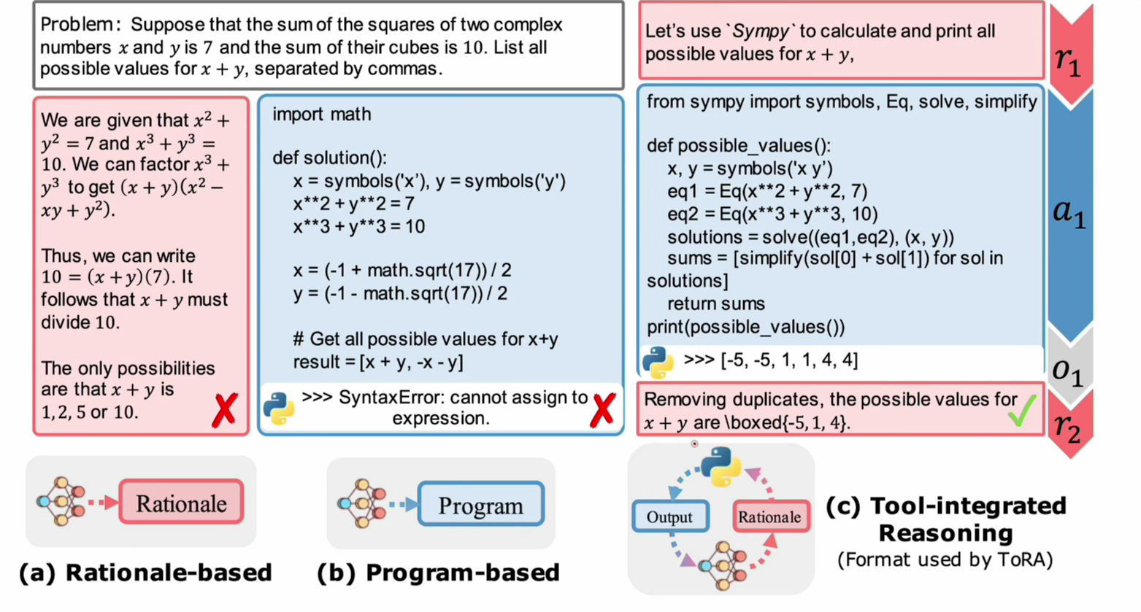

Slide 33
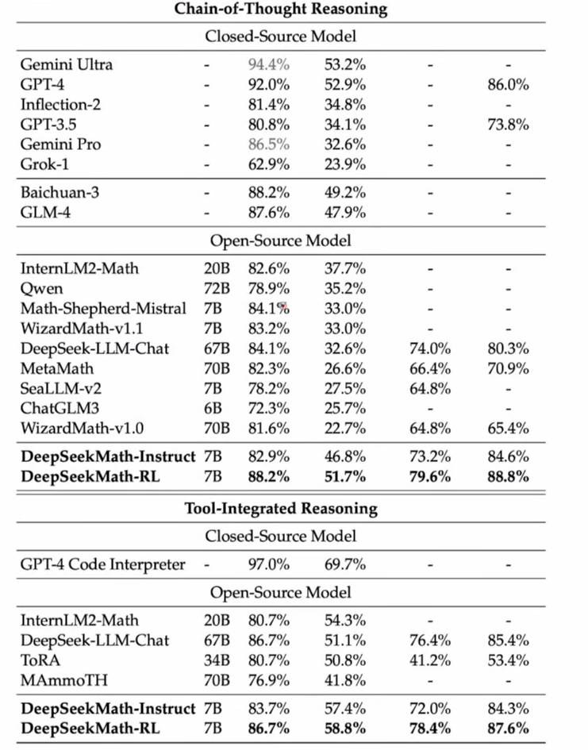

Slide 34
Reinforcement learning
Policy gradient
Baseline
Actor-critic
Advantage actor-critic
TRPO
PPO
GRPO

Slide 35
